Slide 1
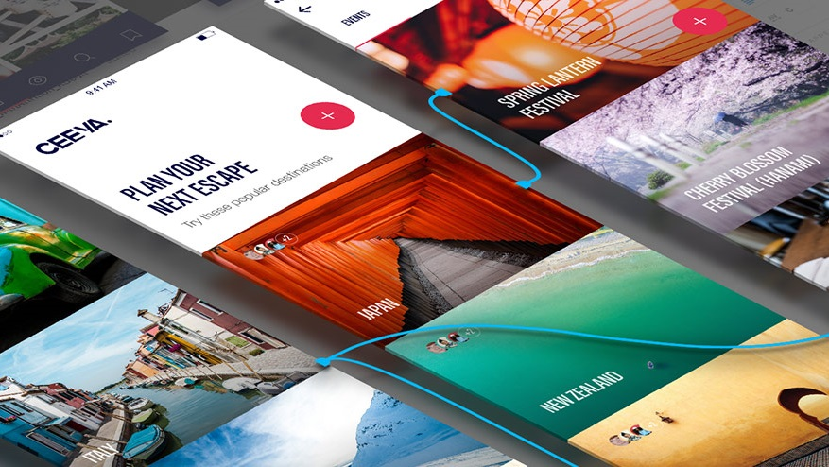
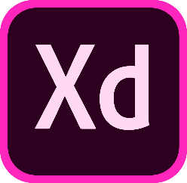
INTRO TO ADOBE EXPERIENCE DESIGN (XD)
UX/UI design and collaboration tool

Slide 2
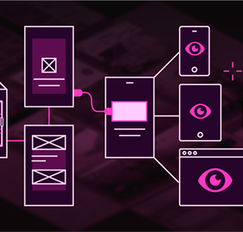
AGENDA
1
Introduction Adobe XD
What is XD and who is it for?
2
From prototype to app
How-to build websites and apps with XD?
3
Let’s see XD in action!
Live demo of app project in XD
4
Take XD for a test-drive
Build for scratch or do the basic tutorial
Notes:
Image source:-
https://pixabay.com/en/technology-industry-big-data-cpu-3092486/

Slide 3

WHAT IS XD?
Adobe Experience Design (XD) is a cross-platform app for designing and prototyping websites, mobile apps, etc.

Slide 4

WHO IS IT FOR?
Aims to be a single app for UX/UI and digital designers to design and create wireframes and app proposals.

Slide 5
XD IS BUILT FOR UX/UI DESIGN
Design and prototype in a single app.
Preview your design live on mobile devices.
XD’s minimal interface is focused on UX/UI design, so you can work faster.
A fast app with small files.
Object-oriented (so you can quickly navigate, move, or adjust elements).
Vector-based, so it’s easy to draw icons, etc.

Slide 6
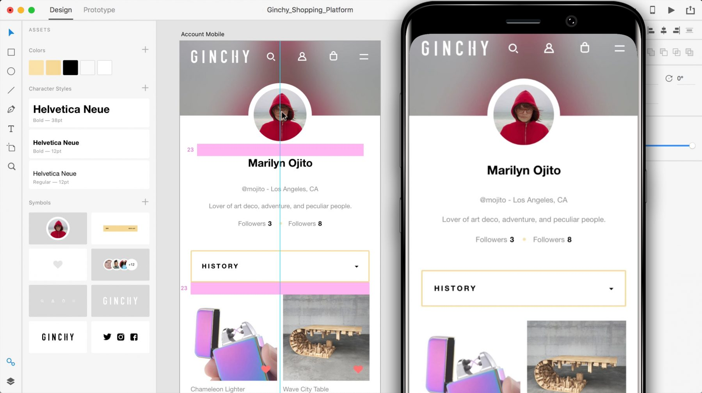
02
From Prototype to App
How can we build website and apps with XD?
Notes:
Image source:-
https://pixabay.com/en/architecture-building-business-2179108/

Slide 7
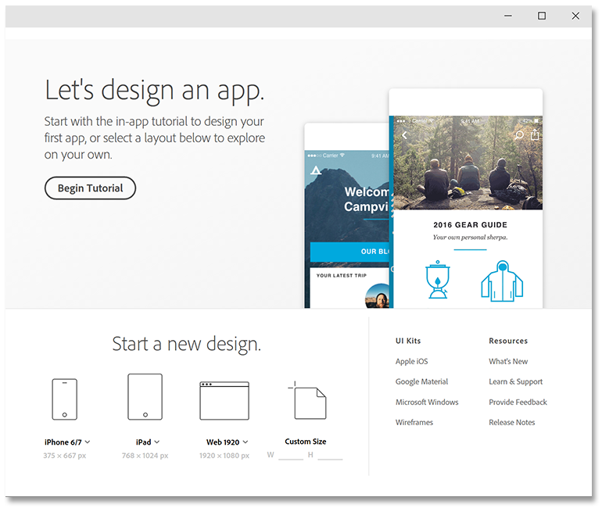
Choose your Device.
Start a new design for one of the different kind of target devices or base your App on one of the available UI kits.

Slide 8
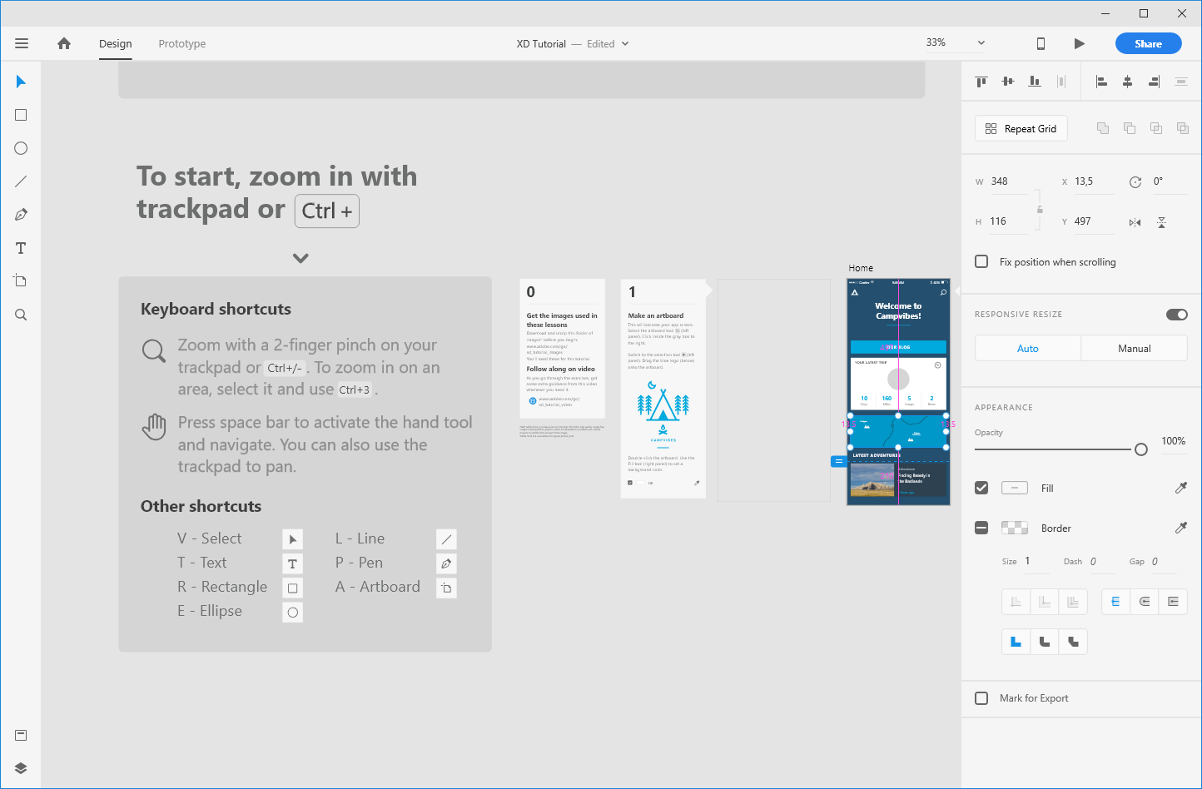
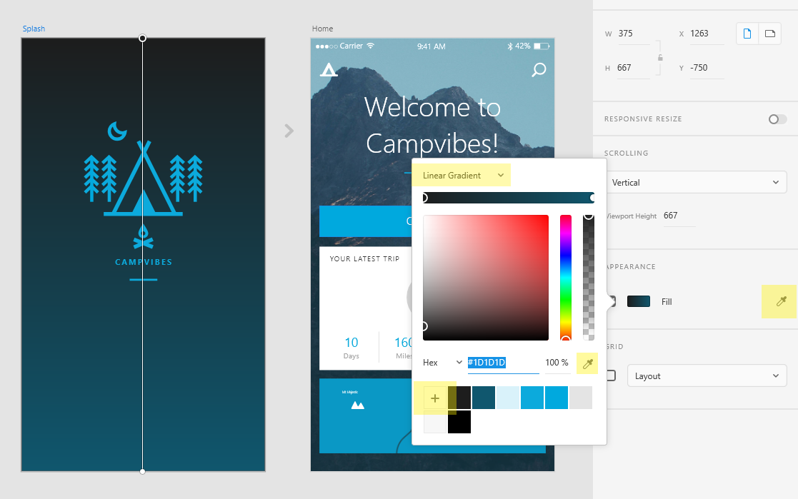
Design your App.
User interface for designing the App with all its assets. Includes Photoshop-like design tools to make a responsive App.

Slide 9
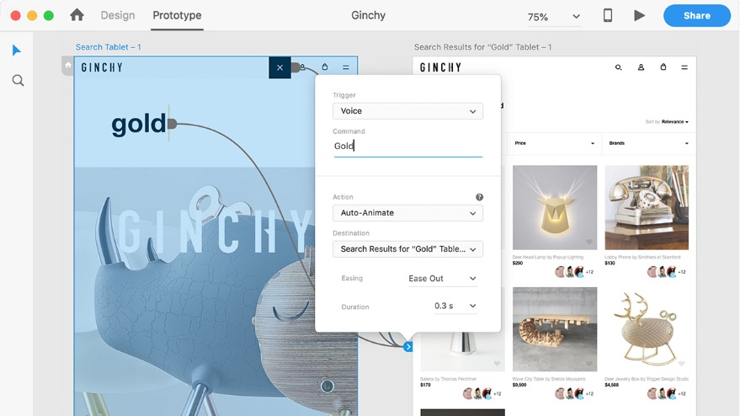
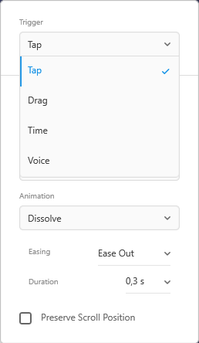
Prototype your App.
Prototype you flow, triggers (e.g. tap, drag, voice command), animation style and duration.

Slide 10
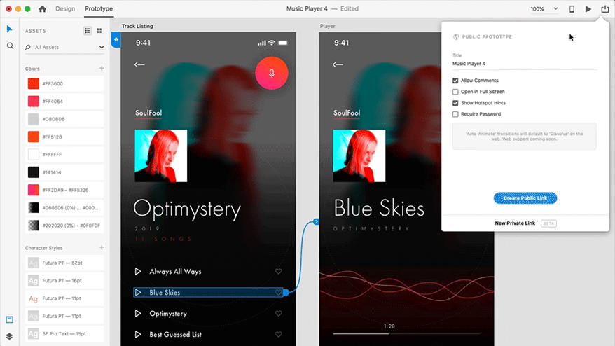
Design. Prototype. Share.
Easily go from design to prototype to sharing the App with customers and developers.

Slide 11

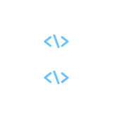
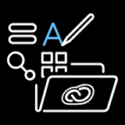

Favorite Features
MODERN UX
PLUGINS
Voice prototyping, Responsive Resize, Auto-Animate / Timed Triggers.
Extend your App with plugins, such as a JSON data plugin & Avocode plugin for code export.
FREE UI KITS
INTEGRATIONS
Each kit comes with templates, artboards, screens, and assets you need for a unique UX.
Connect XD to collaboration apps like Slack, JIRA, and Microsoft Teams.

Slide 12
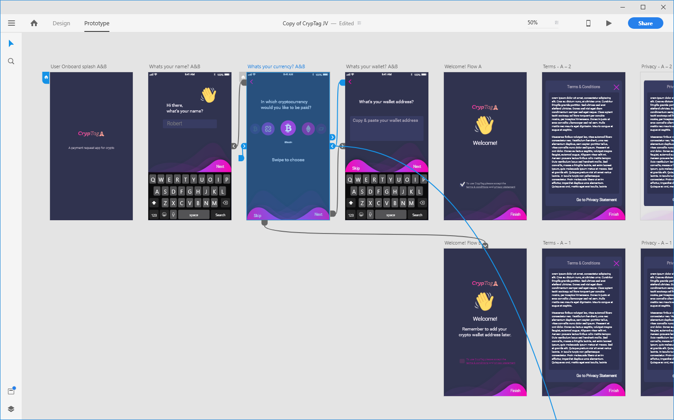
03
Let’s see XD in action!
How does it work in real-world example?
Notes:
Image source:-
https://pixabay.com/en/architecture-building-business-2179108/

Slide 13
04
Take XD for a test-drive
How does it work in real-world example?
Notes:
Image source:-
https://pixabay.com/en/architecture-building-business-2179108/

Slide 14

Test Drive
1
Pick the basic tutorial as a start to do end-to-end example.
2
Pick one of the UI Kits for example Google Material Design and build for scratch.
3
Inspect given example and play around with some advanced functions.
Notes:
Image source:-
https://pixabay.com/en/coding-programming-working-macbook-924920/

Slide 15
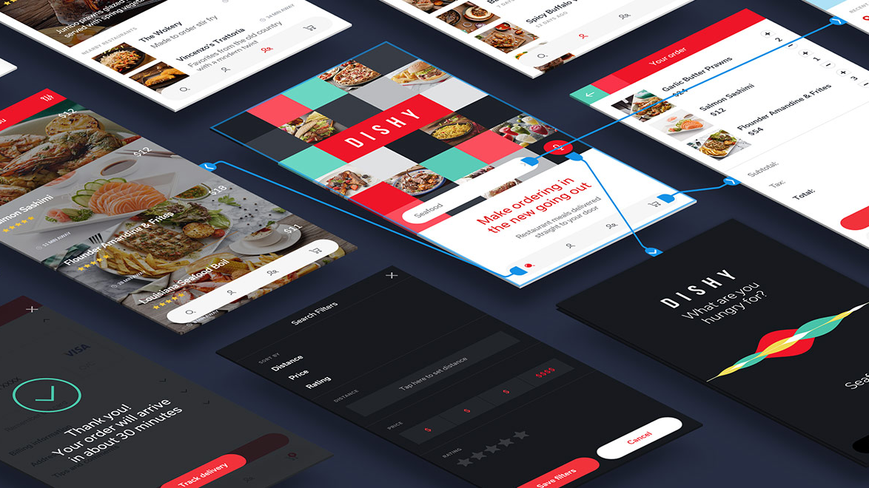
THANK YOU
UX/UI design and collaboration tool

